Slide 1
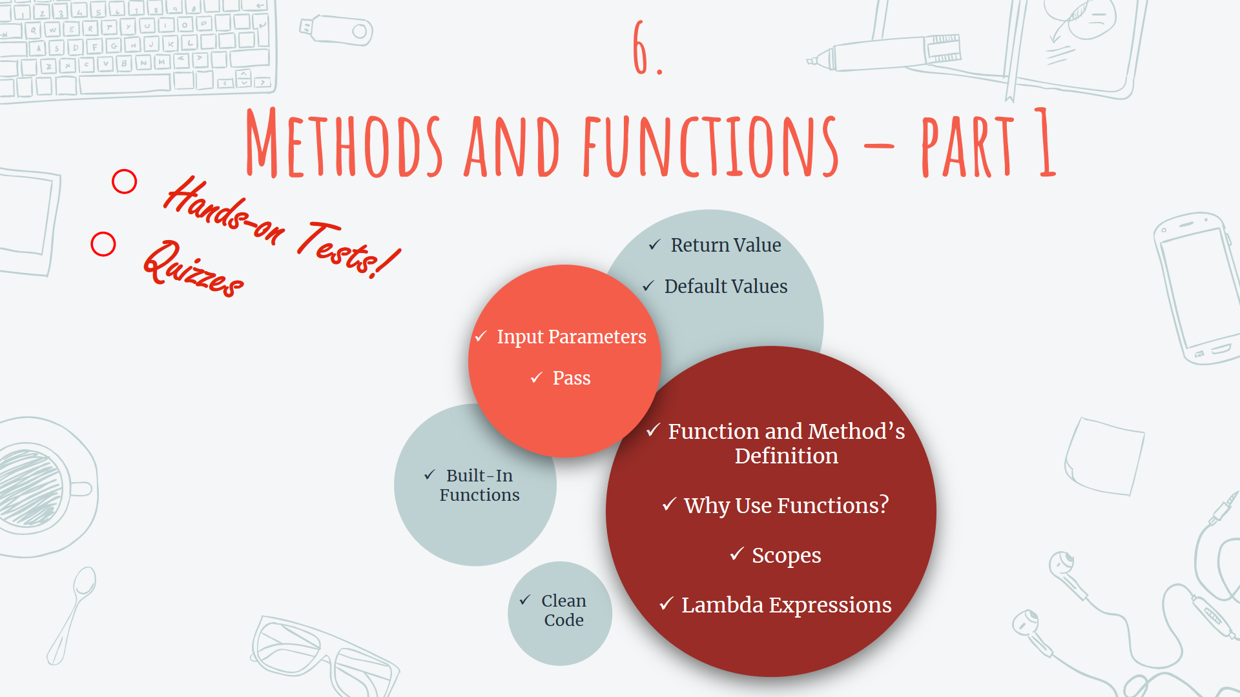

Slide 2
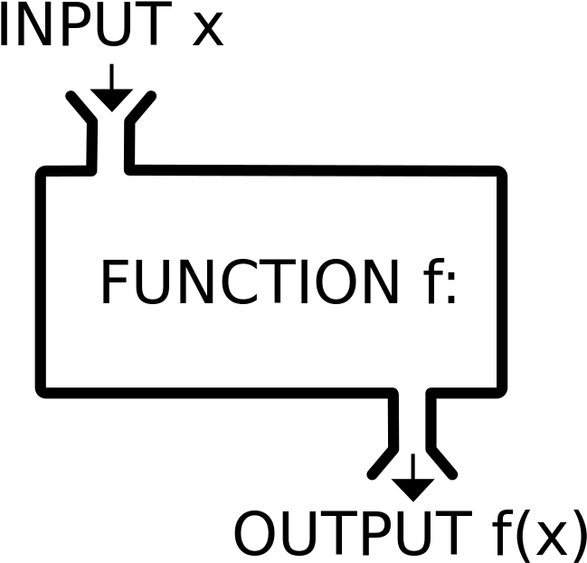
Function Definition
Functions → is a block of code which
1. Accomplishes only a certain task → Single performance
2. For the same inputs, it always returns the same output → Injective, One to one
3. It can be executed only and only when it is called.
4. It can be called multiple times → Reusability

Slide 3
Functions in Python – Definition
The syntax to create a function in Python is as followed:
Always this notation comes to declare the beginning of a new block
The key word to start function’s definition
def function_name () :
#some_code
#some_code
We’ll learn why to use this notation soon. For now just keep in mind to use it.
Indentation is really important for all statements inside the function’s block

Slide 4
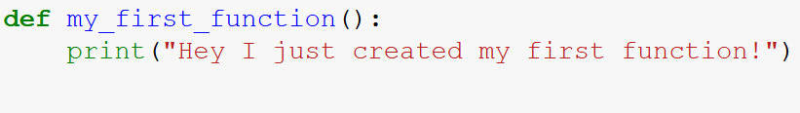
Functions in Python – Definition
A simple example…

Slide 5
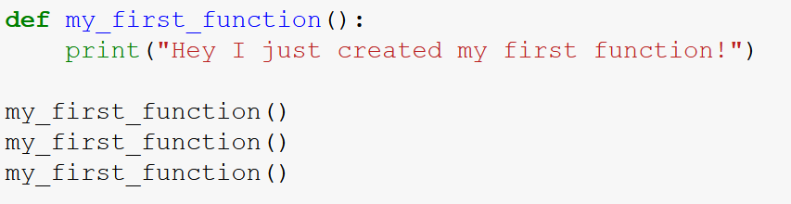

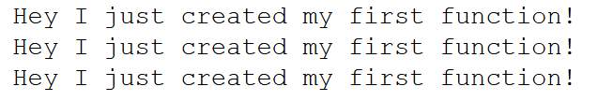
Functions in Python – Calling
The created function will only be executed whenever it’s called.
A function can be called multiple times.
But how to call a function? Take a look at the following example.
The function is defined here
The function is called here 3 times

Slide 6
Functions in Python – Arguments
The information and variables can be passed into function:
def function_name ( arguments ) :
#some_code
#some_code
You can pass as many variables as you want into the function

Slide 7
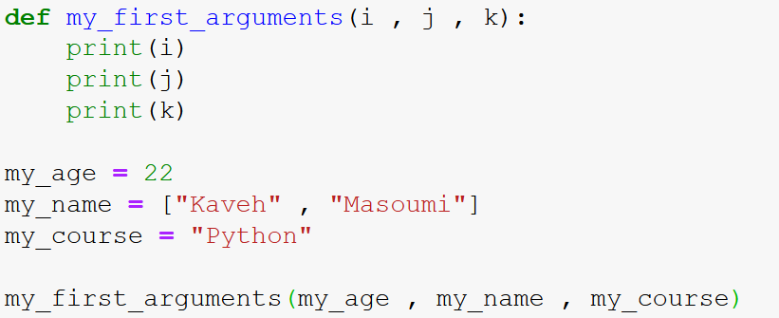
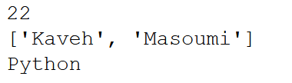
Functions in Python – Arguments
A simple example…

Slide 8
Functions in Python – Arguments
Some important notes about arguments (short form, args):
Always remember:
Number of args in function calls = Number of args in definition
Different types of data can be passed to each arg.
int, float, str, bool variables are only passed as values.
list, dict, set , tuple variables are passed as the variable itself.
Let’s see some examples to see the concept…

Slide 9
Functions in Python – return
A function can also return a value as a result.
def function_name () :
#some_code
#some_code
return some_variable
The value of the variable written in front of the return will be returned

Slide 10
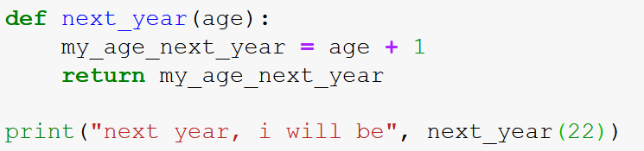
Functions in Python – return
A simple example…

Slide 11
Now let’s get back to the code…

Slide 12

Thanks!
Got any questions or suggestions?
Here’s some contact info:
@KMasoumi

